Slide 1

AUTOMATED TEXT RECOGNITION USING OPENCV
DONE BY:
AJANEESHWAR.S-811721243005
KAMALESHWAR.A-811721243023
NAVEEN KUMAR.K.R-811721243038
SIDDHARTHAN.R-811721243052
Project Guide: Mrs. G. Nalina Keerthana M.E.

Slide 2
OBJECTIVE
To develop a computer vision system that can accurately extract characters from document pages, image data and live visuals using the OpenCV library.

Slide 3
EXISTING SYSTEM
OpenCV is a popular computer vision library that provides a wide range of tools for image processing and computer vision tasks.
The system consists of several modules, including image pre-processing, character segmentation, feature extraction and character recognition.
The image pre-processing module is responsible for cleaning up the input image, removing any noise or artifacts and enhancing the contrast and brightness of the image.
The character segmentation module then divides the pre-processed image into individual characters, which are then processed by the feature extraction module to extract relevant features such as stroke width, aspect ratio and curvature.

Slide 4
PROPOSED SYSTEM
The proposed system focuses on creating a system that can extract the characters from visuals and images with good accuracy rate using Open Computer Vision technique.
OpenCV provides a wide range of algorithms for image processing and computer vision tasks, such as feature detection and extraction, image filtering, segmentation, object recognition and tracking.
It also includes a set of tools for image and video manipulation, such as resizing, cropping and colour space conversion.
The Machine Learning Techniques, such as Support Vector Machine.
K -nearest neighbours are used to achieve high accuracy and efficiency in text extraction.

Slide 5
LITERATURE SURVEY
S.NO | TITLE | YEAR OF PUBLICATION | AUTHORS | ALGORITHMS USED | MERITS | DEMERITS
1. | A Fuzzy Logic based Handwritten Numeral Recognition System. | Research Gate December 10,2013 | Mahmood K Jasim, Anwar M Al-Saleh, Alaa Aljanaby | Reinforcement learning, Fuzzy logic. | Robustness, Scalability, Interpretability,Ease of development | Lack of precision, Complexity
2. | Handwritten character recognition using neural network and tensor flow. | IJITEE April 10,2019 | Megha Agarwal, Shalika, Vinam Tomar, Priyanka Gupta. | Convolution neural network,Optical character recognition | High accuracy, Faster processing | Lack of precision, Complexity
3. | A comparative study on handwriting digit recognition by using convolutional neural network and python | Research Gate, November 11,2019 | Tarun Patel1, Shivansh Tiwari, Vaibhav Dubey, Vaibhav Singh, Dr. Harvendra Kumar | Deep learning, ANN, CNN,HMM | Robustness, Scalability, Interpretability,Ease of development | Overfitting, Black box model, Computational

Slide 6
LITERATURE SURVEY
S.NO | TITLE | YEAR OF PUBLICATION | AUTHORS | ALGORITHMS USED | MERITS | DEMERITS
4. | Handwritten character recognition to obtain editable text | Research Gate, August 13, 2015 | Vaibhav. V. Mainkar, Mr. Ajinkya B. Upade, Jyoti A. Katkar, Poonam R. Pednekar | OCR, Feature Extraction | High accuracy, Faster processing, Time saving | Limited Recognition Ability, Training and customization requirements.
5. | Handwritten character recognition using neural network | IEEE, June 20,2016 | Ayush Purohit , Shardul Singh Chauhan | HMM, ANN, NLP | Accesibility,Reduced data entry | Cost, Privacy concerns

Slide 7
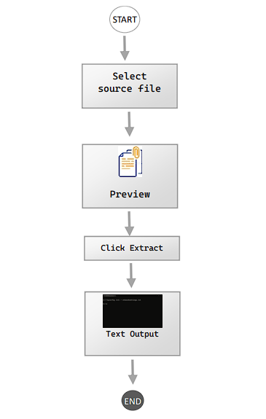
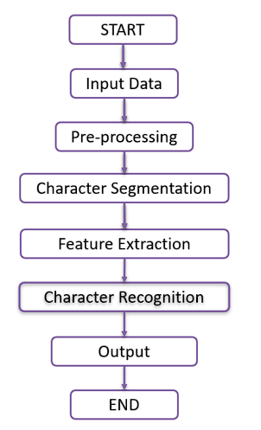
SYSTEM ARCHITECHTURE

Slide 8
SYSTEM REQUIREMENTS
HARDWARE REQUIREMENT
Processor : Dual core processor
RAM : 4GB
Hard disk : 256 GB
Monitor : 15-inch colour monitor
Webcam : 5 MP (minimum)
SOFTWARE REQUIREMENT
Operating system : Windows OS
IDLE : Python Web
Application : Jupyter Notebook
Browser : Any

Slide 9
MODULES
Extraction of Character from Images
Extraction of character from Video
Extraction of character from Visuals

Slide 10
MODULE 1
Extraction of Character from Images
The project abstract outlines the development of a sophisticated computer vision system designed to accurately extract characters from both document pages and image data.
Leveraging the capabilities of OpenCV, Pytesseract, Matplotlib, and Tkinter, this system aims to deliver precise and efficient character extraction functionality across a diverse range of visual inputs.

Slide 11
MODULE 2
Extraction of character from Video
This module represents a sophisticated fusion of computer vision and optical character recognition (OCR) technologies, tailored to process and extract textual information from video feeds in real-time.
At its core, the integration of OpenCV provides a comprehensive suite of tools for capturing, manipulating, and analyzing video frames, ensuring efficient handling of the continuous stream of visual data.

Slide 12
MODULE 3
Extraction of character from Visuals
This module is designed to perform real-time character extraction from a live video stream using OpenCV and Tesseract OCR.
It begins by initializing the video capture using the default camera (index 0). If the camera fails to open, an IOError is raised to alert the user.

Slide 13
ADVANTAGES
High Accuracy and Precision
Efficiency in Processing
Scalability
Open-Source Benefits

Slide 14
APPLICATIONS
Translation Services
Optical Character Recognition (OCR) for Data Entry
Banking and Financial Services
ID and Passport Scanning

Slide 15
CONCLUSION
The proposed system for Extraction of character from Visuals and Images using OpenCV is a robust and efficient solution for extracting characters from images and visual media.
The system is designed to preprocess the images, segment the characters, extract the features, classify them using machine learning algorithms.
Post-process the results to generate accurate output.
Overall, the system is expected to deliver accurate and efficient results in character extraction, making it suitable for applications like document digitization, handwriting recognition and Optical Character Recognition.

Slide 16
REFERENCES
Ayush Purohit, Shardul Singh Chauhan, (2016) "Handwritten Character Recognition using Neural Network" International Journal of Computer Science and Information Technologies, Vol. 7.
Liana M. Lorigo and Venu Govindaraju, (2006) "Offline Arabic Handwriting Recognition: A Survey", IEEE Transactions on Pattern Analysis and Machine Intelligence, Volume 28 Issue 5.
Mahmood K Jasim, Anwar M Al-Saleh, Alaa Aljanaby, (2013) "A Fuzzy Logic based Handwritten Numeral Recognition System" International Journal of Computer Applications (0975 – 8887) Volume 83 – No 10.
Megha Agarwal, Shalika, Vinam Tomar, Priyanka Gupta (2019) "Handwritten Character Recognition using Neural Network and Tensor Flow" International Journal of Innovative Technology and Exploring Engineering ISSN: 2278-3075, Volume-8, Issue- 6S4, April 2019.
Mohammed Z. Khedher, Gheith A. Abandah, and Ahmed M. AlKhawaldeh, (2005) "Optimizing Feature Selection for Recognizing Handwritten Arabic Characters", proceedings of World Academy of Science Engineering and Technology, Vol. 4, ISSN 1307-6884.

Slide 17


THANKYOU

